Slide 1
DecK 3a – basic machine learning applications
Dr. Jack Hong
Adjunct Faculty, Lee Kong Chian School of Business, SMU
Co-founder, Research Room Pte. Ltd.

Slide 2
Introduction to machine learning

Slide 3
introduction
We will not cover all machine learning methods, but only those that are most effective and widely used
There are too many algorithms out there!
Machine learning algorithms are classified into 2 categories:
Supervised learning
Unsupervised learning

Slide 4
Supervised learning
Train a model to learn from labeled training data
Each observation is classified with an outcome (e.g. Spam or Not Spam) or a continuous variable (as in regression)
We extract features from each observation
In the above example, the words that occur in each email
Can also include other variables such as time, name of sender, title etc
Compute a probability of outcome (spam or not spam) associated with the presence and absence of the features
In the case of the continuous variable, to minimize the loss function
Reinforcement learning is about improving a model’s performance based on its interaction with the environment
Uses reward function compared to loss function
E.g. Chess engine: System decides moves based on the state of the board, and the reward function will determine win or lose as the outcome

Slide 5
unSupervised learning
In supervised learning, we know the answer beforehand
In unsupervised learning, we deal with unlabeled data
Unsupervised learning techniques allow us to explore the data structure to extract information without any prior guidance
Clustering: grouping observations by similarity and dissimilarity
Dimensionality reduction: removing noise from data while compressing high dimensional data into smaller ones

Slide 6
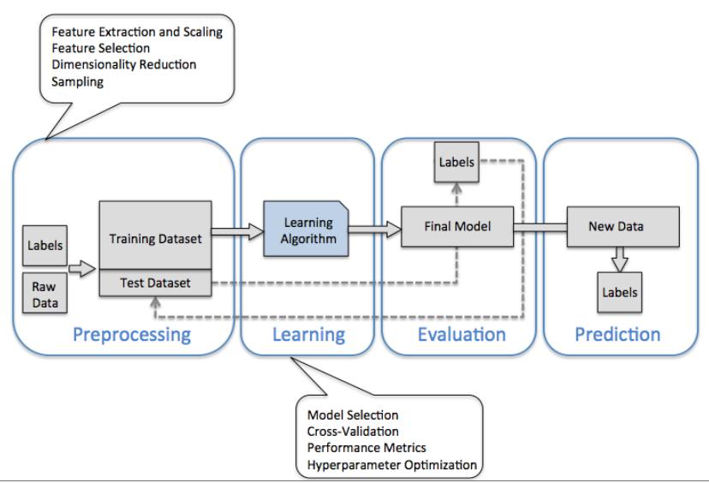
Where does machine learning fit in the Data science value chain?
Data Collection
Data Exploration
Prediction/ Prescription modeling
Data Munging

Slide 7
DATA MUNGING IN PYTHON

Slide 8
DATA MUNGING IN PYTHON
Data munging is a necessary but dreaded process in data analytics
Involves cleaning, transforming, and setting data the right way
Compared to R, Python is more powerful (and convenient) in data munging
Data scientists use the pandas package for this purpose
Pandas is developed by Wes McKinney, a Financial Economist
a financial economist to handle economics and finance datasets (refer to panel data setup in Lesson 3)
Pandas got its name not from the animal but because it was meant for handling panel data.
The package was so useful that its now the de-facto data munging package in Python

Slide 9
Important techniques using pandas and scikit-learn
I’ll cover a few key techniques that you will use frequently
Upload “ML introduction.ipynb” and “wine.csv” into your Jupyter dashboard
Follow the comments and instructions
This notebook tutorial covers data munging and predictive modeling
To know more about pandas, you may refer to https://pandas.pydata.org/pandas-docs/stable/10min.html for the official 10 minutes guide to pandas

Slide 10
Perceptron learning
Where it all started for machine learning

Slide 11
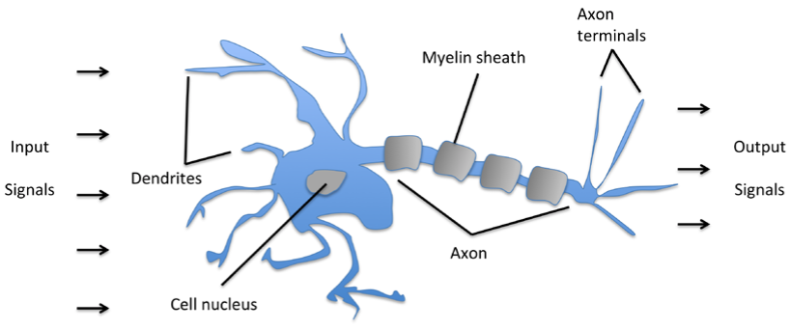
The beginnings of machine learning
Early works in machine learning attempts to mimic how a brain cell works, in simplistic forms
Simple logic gate with binary outputs, triggered by the level/strength of accumulated signal against a threshold

Slide 12
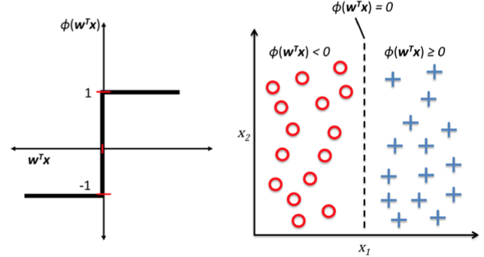
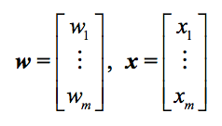
Perceptron learning – Basic ML illustration
Based on the Neuron model, Frank Rosenblatt conceptualized a learning rule that would
Automatically learn the optimal weight coefficients
Multiplied with the input features
Decide whether a neuron fires or not
This is akin to a classification task
In the below example, we use a step function (if x > 0.5, y = red) (else y = blue)
All values of x will then be mapped into a y-value of 1 or 0
Example: If humidity is > 60%, it will rain, else it will not
weights
input
activation function

Slide 13
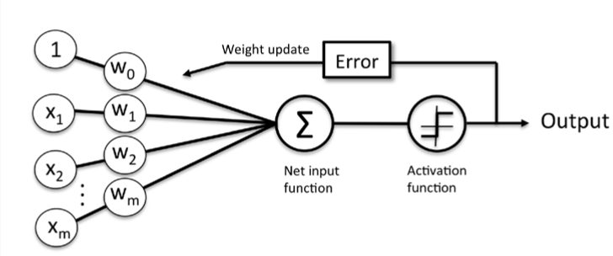
How does the model learn?
An ML model learns by iteration
It chooses a set of starting weights for each feature input
Throws it through the activation function and compares the predicted output against the actual
The model continuously attempts to reduce the error (actual – predicted) by changing the weights for the input features

Slide 14
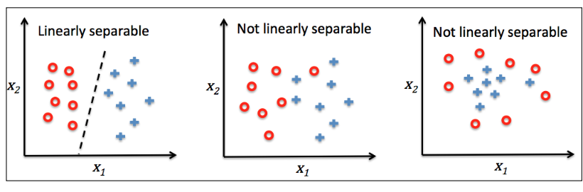
Perceptron learning
Intuitively, we can see that this method adopts a linear separation mechanism to split samples via a boundary
However, if the samples cannot be perfectly separated, then the perceptron will never terminate
The solution is to allow some kind of error threshold (e.g. 20% misclassification)
We can generalize this perceptron model and change the step function to other functional forms
Such as the linear and logistic models we learnt in Lesson 3
Machine learning is very closely related to statistical modeling

Slide 15
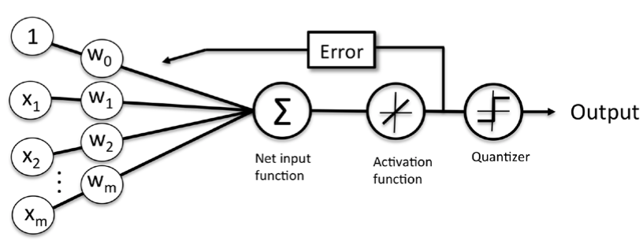
linear regression in machine learning
The linear regression model is implemented in machine learning by using a linear activation function
This ML model is known as Adaline

Slide 16
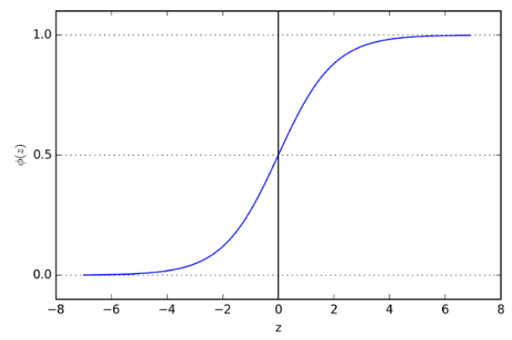
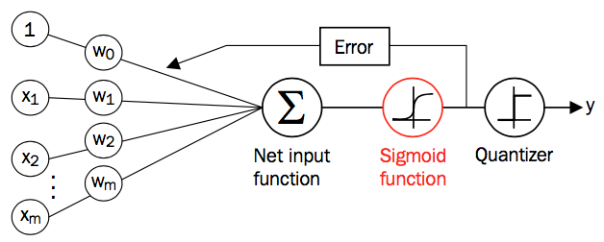
Logistic regression in machine learning
Recall that logistic regression uses a logit function to map values of x to a range bounded by (0, 1)
In machine learning, such a function is known as the sigmoid function due to its S-shape
Implementing the logistic regression in ML is simply using the sigmoid function as the activation function
Sigmoid function

Slide 17

Gradient descent i
By changing the activation function to a linear function, we are attempting to fit data into a linear form, similar to the linear regression
The model error is now computed based on a linear prediction
Like regression models, the objective of the ML algorithm is to find a set of weights for each input feature that minimizes predictive errors (mathematically, its defined as the sum of squared errors)
This is the general principle of supervised machine learning algorithms:
Define an objective function to be optimized by reducing the error between predicted and actual values
Shift the weights to find the minimum error rate achievable (in machine learning speak, we also call error the cost)

Slide 18
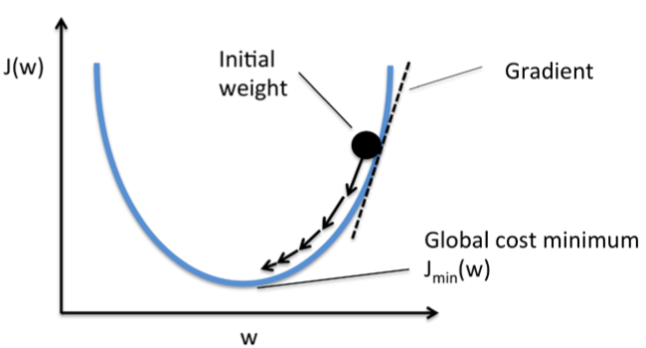
Gradient descent ii
Analogous to climbing down a hill to reach the bottom of the valley
Hyper-parameters
For the above model, there are 2 parameters that we need to care about as we perform the gradient descent
Number of iterations: How many times should we move the weights around?
Learning rate: How much movement should each iteration allow?

Slide 19
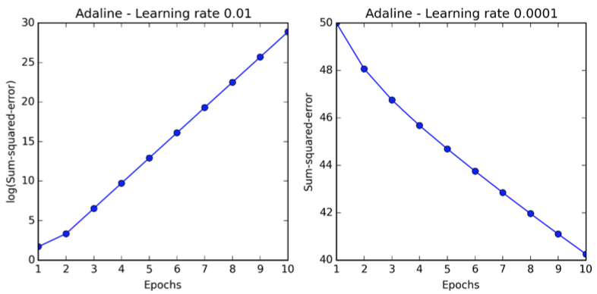
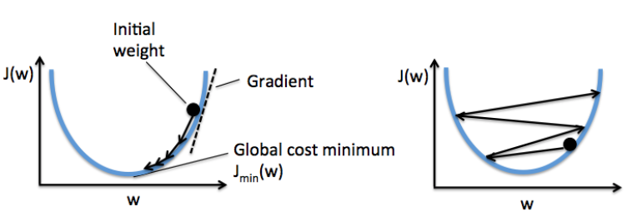
Choosing hyperparameters
A small learning rate requires a large amount of iterations to converge
However, if the learning rate is too large, we keep overshooting the global minimum and errors increase
Hyperparameter tuning (finding the best hyperparameter) is an indispensable step in machine learning modeling
There are many tricks to hyperparameter tuning but we will not cover them in this course

Slide 20
Predictive accuracy

Slide 21
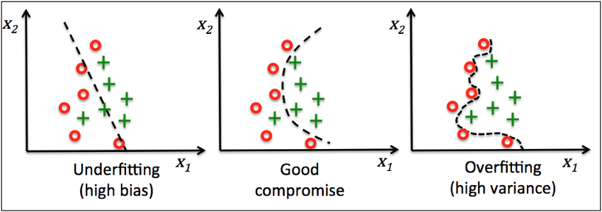
Overfitting and underfitting
Recall in Lesson 3, we had to split the dataset into training and test set
Because a model tends to perform well on data it has “seen before” (in-sample data)
This has an upward bias on reported predictive accuracy
Performs well on training data, but badly on out-sample data
The solution is to train the model in-sample and test it on out-sample data
The name of this problem is known as “overfitting”
In contrast to overfitting, underfitting is another issue where the model is too naïve (e.g. too little features) to capture significant patterns in the training data
Reported predictive accuracy is weak for both in and out-sample data

Slide 22
Regularization to combat over and under fitting
Finding a good trade-off requires some form of tuning on the complexity of the model
Regularization is a good method for this purpose
Can handle collinearity and filter noise
Introduce bias to penalize extreme parameter weights
Called L1 or L2 regularization, or a mix of both
Most commonly used: L2 regularization (also called shrinkage or weight decay)
Regularization parameters are included as hyperparameters in most ML algorithms in Python’s scikit-learn package

Slide 23
Support vector machines

Slide 24
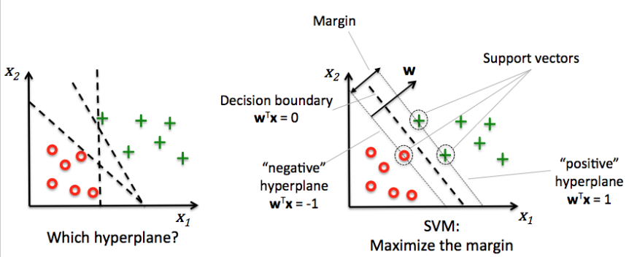
Support vector machines (svm)
A popular and powerful ML algorithm extended from the Perceptron model
Recall the optimization objective of the Perceptron model is to minimize errors
SVM’s optimization objective is to maximize the distance between observations separated by a decision boundary called the hyperplane
In other words, SVM optimizes by maximizing the margin
Note that hyperplanes can be multi-dimensional (which is often the case)

Slide 25
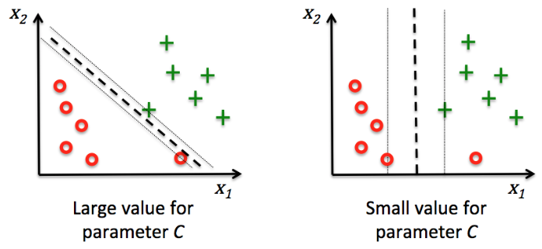
Separation with errors
In the event that a perfect cut cannot be established, the SVM model allows for a threshold of misclassification errors
In the below example, the parameter C defines this threshold
The value of C corresponds to the size of the penalties for misclassification errors

Slide 26
SVM for Nonlinear problems
Kernel SVM
Used when its not possible for us to separate positive and negative outcomes using linear methods
The idea is to create nonlinear combinations of the original features/variables and project them onto a higher dimensional space via a mapping function
then we can do a linear hyperplane in this higher dimensional space
map it back to the original lower dimensional space after we are done

Slide 27
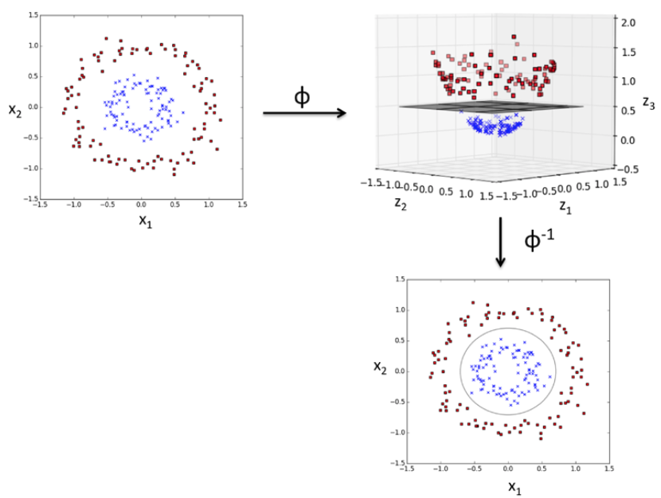
Mapping function
Example:
Transform a 2-dimensional dataset into a 3-dimensional one
In this case, the closer the values of X₁ and X₂ are to the center, the lower the Z value is
Use a linear function to cut a line between the red and blue observations
Transform the results back into 2-d

Slide 28
Decision trees

Slide 29
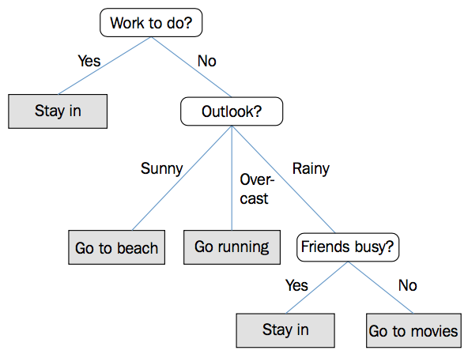
Decision trees
Decision trees are so named because the model breaks the data down by decision-based questions
Features can be categorical, as well as continuous

Slide 30
Implementing decision tree learning
The splitting rule at each node of the tree acts on the feature that results in the largest Information Gain (IG)
This is repeated at each child node until the observations at each node all belong to the same class
As such, decision tree models are extremely good at fitting
The model can create, shrink, and expand boxes to envelop datapoints with the same outcome variable
However, such a procedure is prone to overfitting
Techniques such as pruning (sets a limit for the maximal depth of the tree) help to mitigate this

Slide 31
Ensemble methods

Slide 32
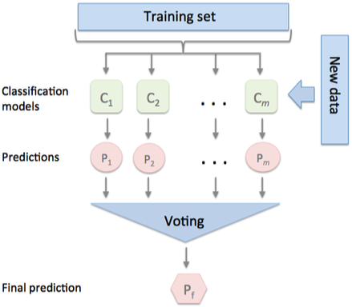
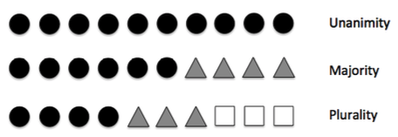
What are ensemble methods?
Combining individual classifiers into a meta-classifier can realize better out-of-sample performance
Generally, ensemble methods collect predictions from multiple models and use a voting mechanism to choose the best result

Slide 33
Random forest
Random Forest is a type of ensemble method built on decision trees
RF is simply a collection of decision trees
A very simple adaptation but often results in drastic improvements to predictive accuracy
Good performance, scalable and easy to use
Combining weak learners to build a strong learner
The idea that multiple independent models give better results than a single model
Assuming 100 classifiers that are each correct only 55% of the time
However, the probability that the majority of them are correct increases to 82% (cumulative binomial probability)
Other ensemble methods: bagging and boosting

Slide 34
Implementing random forest
Bootstrap a sample of size n
Bootstrapping is a method of sample selection where we make random selections with replacement
Grow a decision tree using this sample
At each node, randomly select d features without replacement
Split this node using the best feature
Repeat the above steps k times
Aggregate the prediction by each tree and assign the class to the data via majority voting

Slide 35
Some remarks
Random forest model is a black box
Cannot be interpreted like a decision tree where you know that branches come out of important features
Random forest is a bunch of trees, and the prediction is a result of majority voting (i.e. most of the trees predict this outcome)
However, RF has the following advantages
No need to worry about hyperparameter values
Don’t need to prune the forest
Only need to choose the number of trees
The larger the number, the better the performance
However, the larger the number, the more expensive the computational cost

Slide 36
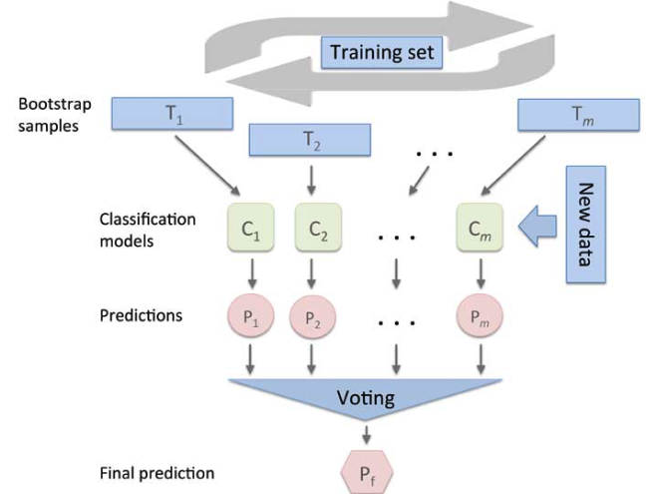
Bagging – an alternative to majority voting

Slide 37
boosting
3 commonly-used techniques
Adaptive boosting (adaboost)
A type of classifier boosting
Stochastic Gradient boosting
A type of regression boosting
Extreme gradient boosting (xgboost)
A type of tree ensemble (combination of classification and regression trees)
Fits a regularization variable in the objective function to prevent over-fitting
The basic concept behind boosting is to start with very simple base classifiers (slightly better than random guessing)
These simple classifiers are called weak learners (e.g. 2-layer decision tree – they call this a stump)
Continuously make the weak learners learn from misclassified samples
Draw a random subset without replacement and train a weak learner
Draw a second subset without replacement, add 50% of the misclassifed samples in (1), and train another weak learner
Find the training samples that both (1) and (2) disagree, and train a third weak learner
Combine all 3 learners via majority voting
Note that boosting algorithms have a tendency to overfit

Slide 38
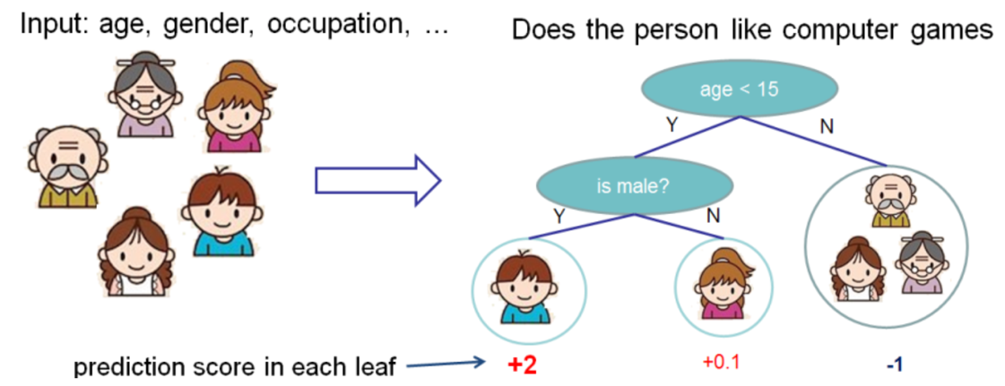
Xgboost
Tree ensemble
Combination of classification and regression trees (CART)
In normal decision trees, the leaf contains the decision values
In CART, the leaves contain a real-valued score

Slide 39
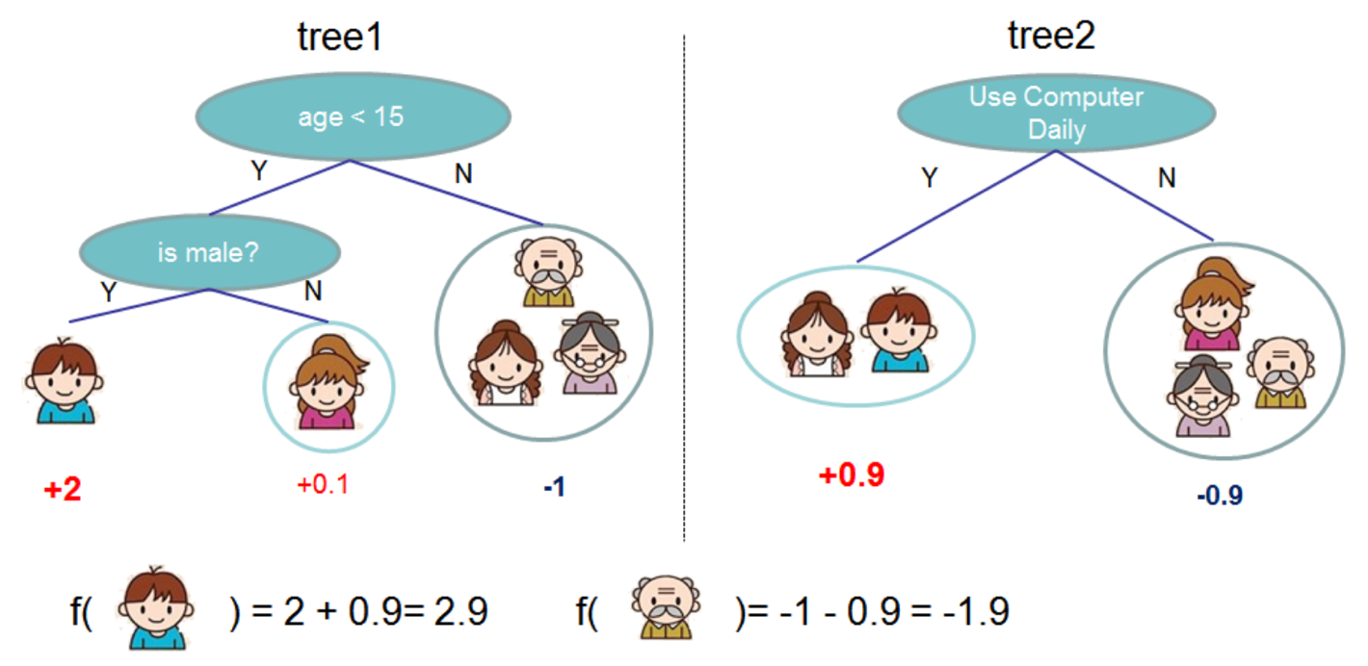
Tree ensemble
Example of 2 trees
Prediction scores are summed to get the final score
Note that the two trees complement each other

Slide 40
Some comments about ensemble techniques
Non-trivial increases in computational complexity for (usually) modest improvements in predictive performance
$1 million Netflix Grand Prize
For 3 years straight, thousands of teams could only improve upon the previous years results
Model tuning, factorization, simple ensembles etc
Could not beat the challenge of 10% improvement over the native Netflix recommendation algorithm
In 2009, a combined team (BellKors Pragmatic Chaos) beat the challenge using a complex blend of ensemble techniques
However, Netflix never implemented the winning model due to its complexity (development, execution and maintenance efforts that are not feasible for real-world application)

Slide 41
Exercise
Upload “machine learning I.ipynb” into your Jupyter dashboard
Follow the comments and codes and feel free to try out new codes on your own
The visualization codes are meant to create graphs to help you picture the shape of the solution, don’t crack your head trying to understand the codes!
The point is to help you build your intuition to what the ML model does

Slide 42
Unsupervised learning

Slide 43
Unsupervised learning
Up till this point, we have been dealing with problems where we have an answer to (outcome)
All our regression equations are setup with an outcome variable on the LHS
What happens when we suspect that there are relationships, subsets or clusters in our data, but have no answers upfront?

Slide 44
clustering
Clustering is a category of unsupervised learning that helps us discover hidden structures and natural grouping in data based on a similarity function
K-means
Hierarchical
Density-based
Graph-based (basis of network theory)
Other unsupervised learning algorithms
Association rules (Apriori)
Mixture models, Factor models, and Latent models

Slide 45
K-means clustering
The most widely used clustering algorithm in academia and industry
Easy to implement
Computationally efficient
Concept
Find groups of similar objects based on a distance function that makes them more related to each other than to objects in other groups
Issues
Requires us to specify number of clusters k
Inappropriate choice of k can result in poor clustering
We can determine the optimal number of k using elbow and silhouette plots
Clusters do not overlap and are not hierarchical
Clusters can be empty!

Slide 46
Steps to implement k-means
Randomly pick k centroids from the sample points
Remember that we have to manually specify the number of clusters k
Assign every sample to its nearest centroid
Move the centroids to the center of the samples
Repeat steps 2 and 3 until
Cluster assignments no longer change
User defined threshold has been reached
Number of iterations
Error rate

Slide 47

Distance measure
The key mathematical function in clustering is the distance function
This is a measure of similarity between objects
The nearer 2 objects are together, than to others, the more likely they belong together in a cluster
The most commonly used distance function is the squared Euclidean distance
Note that in 2-d form, it’s the same as how we measure straight-line distance between 2 objects
The generalized vector form is:
The objective is to minimize the within-cluster sum of squared errors

Slide 48
Exercise
Upload “Machine Learning II.ipynb” into your dashboard
Follow the comments and instructions
Use the visualization to build your intuition as to the shape of the solution

Slide 49
Model evaluation and hyperparameter tuning

Slide 50
Next steps
Previous sections have familiarized us with the basics of machine learning algorithms
Building good models, however, require more than just knowing when to use which algorithms
We need to have a framework for evaluating model performances in response to algorithm fine-tuning
Some of these are best practices contributed by the data science community

Slide 51
Using pipelines to streamline workflows
You may have noticed that we have been using and reusing multiple data preprocessing, compression and hyperparameters
Some of these processes require that we fit training and testing datasets with the same parameters (e.g. scaling and compression transformation)
Scikit-learn comes with a very useful tool that enhances this workflow
Known as the Pipeline

Slide 52
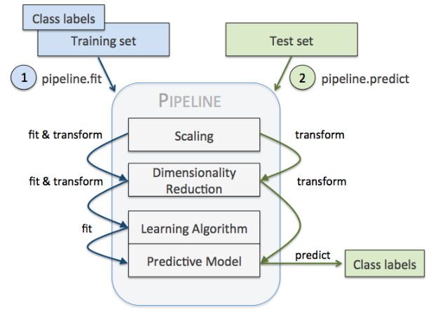
Pipeline workflow

Slide 53
Assessing model performance
As covered in the previous sessions, model performance should be evaluated on ’never-seen-before’ data or out-of-sample data
Model performance can fall under the following 3 types:
Underfitting (model too simple, poor in-sample and out-sample performance)
Overfitting (model too complex, not generalizable and thus poor out-sample performance)
Good balance (this is what we want)
We can use cross-validation techniques to figure out what the good balance is
Holdout method
K-fold

Slide 54
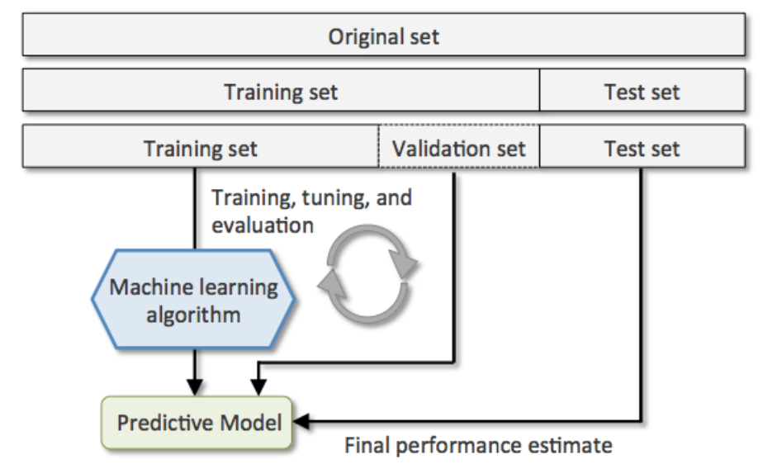
The holdout method
Split the data into 3 sets:
Training set: used to fit the models
Validation set: models with the best performance on this set will be selected
Test set: final performance estimate
However, performance estimates are sensitive to how we partition the data
Not the best CV method, though many still use this

Slide 55
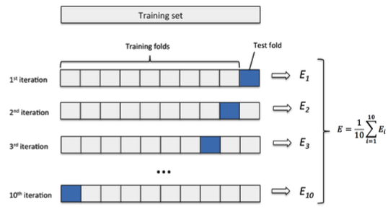
K-fold cross validation
The preferred method for performance evaluation
10 folds is the standard
But we will need to increase the number of folds for smaller and smaller datasets (up to leave-one-out for very small datasets)
Note that this will increase computational time
Also, the training samples will be pretty much similar to each other (the fitted models don’t differ much from each other)
To handle unequal class proportions (which can be a huge issue if the inequality is large), we can preserve the proportions in each fold
This is known as the stratified k-fold cross-validation

Slide 56
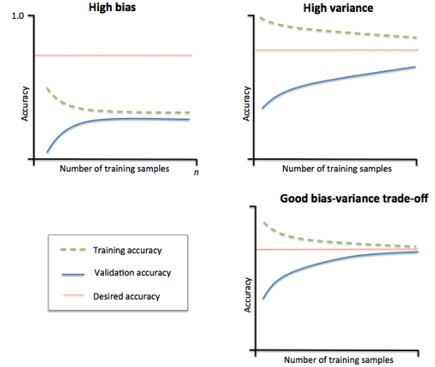
Performance diagnostics
We can use learning and validation curves to diagnose our results
Learning curves
Estimate underfitting vs overfitting
Graph on upper-left has low training and cv accuracy (underfitting)
Increase variables through collection or transformation
Decrease regularization (increasing c)
Graph on upper-right has high training but low cv accuracy (overfitting)
Increase observations
Decrease complexity through feature selection or extraction
Increase regularization (decreasing c)
Validation curves
Improve models by varying parameters

Slide 57
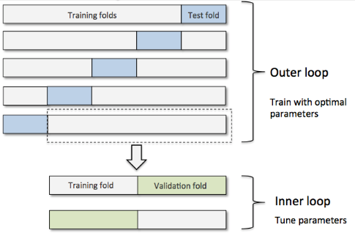
Other useful techniques
Grid search
Similar to validation curves, we specify a list of values for each hyperparameter
This method finds the optimal combination of hyperparameter values in a brute force exhaustive manner
Nested cross-validation
Performing this test on different ML algorithms can aid us in choosing the best candidate model
Exhibits good performance in academic papers

Slide 58
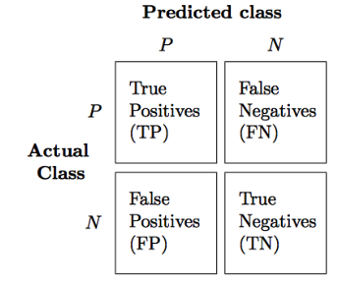
confusion matrix
We can drill deeper into the accuracy measure to evaluate a model’s precision and recall
Precision, recall and the associated F1-score is represented by a confusion matrix
The % of true and false positive/negative
Precision is the % of true positives over true and false positives
How many of the predicted positives are indeed true?
Recall is the % of true positives over true positives + false negatives
How many of the actual positives are correctly predicted?
The F1 score is 2 x (Precision x Recall)/(Precision + Recall)

Slide 59
Exercise
Upload “Tuning and Performance.ipynb” and “wdbc.csv” into your dashboard
Follow the comments and instructions
As part of a final exercise, we will let you explore a financial dataset using the techniques that we have learnt
Upload “key_financials.xlsx” into your Jupyter dashboard
Upload “financial_exercise.ipynb” into your Jupyter dashboard
Follow the comments and codes and attempt the questions

Slide 60
Questions?
Email any queries to
jackhong@smu.edu.sg

